Slide 1




Nutrition For The
Younger Athlete

Slide 2
Why am I here?
Why is Nutrition Important?
General Nutrition for Young Athletes
Nutrition For Training
Nutrition For Competition
Take Away Tips on Nutrition for the Younger Athlete
Who is Optimum Nutrition?
Questions?

Slide 3
Why is Nutrition Important?
Nutrition underlies all performance
Bad nutrition leads to bad performance
Good nutrition leads to good performance
Good nutrition isn’t just necessary prior to competition- it is just as important during regular training as this is where all the hard work is done
Lets not forget though….nutrition isn’t just key to performance…..it is important to growth and health

Slide 4
Why is Nutrition Important?
Do more
Increase work rate
Stronger, Faster
Promote adaptation
Feel better
Facilitate recovery
Train better
Decrease infection / reduce inflammation

Slide 5
General Nutrition For Young Athletes
Age | Boys (kcal) | Girls (kcal)
11-14 yrs | 2220 | 1845
15-18 yrs | 2755 | 2110
Dept. Health. 1991
This shows the average daily energy requirement for children- however this doesn’t account for exercise!
1400 kcal is roughly how much energy is expended in 2hrs of swimming
Therefore the table would look like this.
Age | Boys (kcal) | Girls (kcal)
11-14 yrs | 3620 | 3245
15-18 yrs | 4155 | 3510

Slide 6
General Nutrition For Young Athletes
What does that look like in food?
Unfortunately there are no set values as such although the guidelines below will help.
If your child shows that they generally have a lot of energy, the are probably consuming the right amounts of calories.
If they look lethargic then this is when portions, amounts of calories and where those calories come from needs to change.
Guidelines should be based on:
  Min 50% of energy from Carbohydrates
    11% from Sugar
  Max 35% of energy from Fats
    11% from Saturated Fats
  1-1.5g of Protein per kg of bodyweight

Slide 7
Nutrition For Training
Pre Training
Most of the energy provided for training or competition will be from several hours or even days before
Food eaten before training needs to stop the athlete feeling hungry during training, be easily digested and have a moderate GI (Glycaemic Index)
This doesn’t mean lots of sugary drinks or snacks!
Timing is Key
Most athletes may not have adequate time for a meal between school and training.
Therefore a snack such as cereal bars/yoghurt and apple or banana/dried fruit/cereal with milk/crackers or rice cakes with cheese/muffins (watch the sugar!!)
Consumed 1hr before training
If longer (2-3hrs before training) then a meal such as jacket potato with cheese or tuna or baked beans/pasta with tomato based sauce and cheese/rice or noodles with chicken/porridge.

Slide 8
Nutrition For Training
Post Training
Key to refuel/replenish/maintain/recover.
Not just food but FLUIDS as well!
it determines how fast an athlete will recover- 1g of carbohydrate per kg of body weight eaten within 2hrs speeds up recovery.
Timing is Key
It is important to start the recovery process as soon as you can after training
As soon as an athlete has finished training they should start recovery, this should follow the simple steps of: Straight after have a recovery shake if necessary to kick start recovery → a cereal bar/muffin/smoothie/mini-pancakes with fluids on the way home → followed by a meal.
Need to consume all within 2hrs of training max.
Aim of the meal post exercise is to replenish glycogen stores and start recovery of muscles with protein.

Slide 9
Nutrition For Competition
Similar to that pre/post training, however it is sometimes difficult to maintain due to travelling etc.
Pre Competition
Full meal pre competition, similar to that of pre training.
To Take Poolside
Bananas, Fresh/Dried Fruit, Crackers/Rice Cakes, Bagels/Mini Pancakes/Light Sandwiches, Fruit/Cereal/Energy Bars, FLUIDS!
Tip
Do not eat or drink anything new

Slide 10
Hydration
Dehydration can severely compromise performance especially in young athletes as they are unable to regulate heat as well as adults.
Therefore they:
Sweat less than adults
Get hotter during exercise- especially in humid conditions
Fail to respond to feelings of thirst
Tips to beat dehydration for the younger athlete
200-250ml 45 mins before exercise
100-125ml every 15-20mins during exercise
Drink freely after exercise until no longer thirsty or 300ml for every 0.2kg lost
Tip- get the athlete to weigh themselves pre and post training to see fluid loss

Slide 11
Top Tips
Test the meals before competition
Test drinks before competition
Change the meals so it is not repetitive- also gives variety to food sources
Lead by example
Don’t reward performance with Fast Food
Encourage them to top up fluids throughout the day

Slide 12
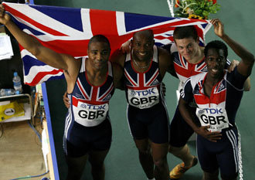
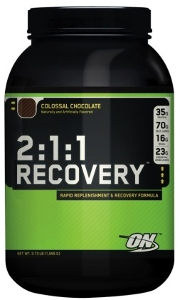
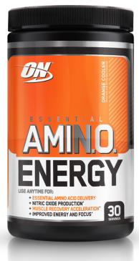













Optimum Nutrition
Biggest Global Sports Nutrition Company within the protein category
Gold Standard 100% Whey is the biggest selling protein product in the world
Key products for Swimming:

